Slide 1
PRAGATI CAMPUS NAVIGATION SYSTEM
A Smart Digital Guide for Students and Visitors

Slide 2
PROJECT OVERVIEW
Complex Layout: Large campuses often have confusing paths between
specialized blocks (e.g., AIML vs. Mechanical).
Inefficiency: Time wasted by visitors asking for directions.
Static Maps: Traditional paper or image-based maps don't show the
user’s "Live" location.

Slide 3
PROBLEM STATEMENT
Complex Layout: Large campuses often have confusing paths between
specialized blocks (e.g., AIML vs. Mechanical).
Inefficiency: Time wasted by visitors asking for directions.
Static Maps: Traditional paper or image-based maps don't show the
user’s "Live" location.

Slide 4
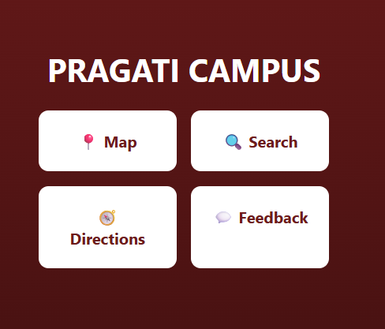
CORE FUNCTIONALITIES
Interactive Map: Built using Leaflet.js and OpenStreetMap data.
Smart Search: Quickly fly to any block (Main, ECE, Canteen,
etc.) via the search bar.
Point-to-Point Directions: Choose a "From" and "To" location to
draw a visual navigation path.
Live Geolocation: "Locate Me" feature to find your real-time
position on campus.
Responsive UI: Designed for mobile-first usage with an intuitive
dashboard.

Slide 5
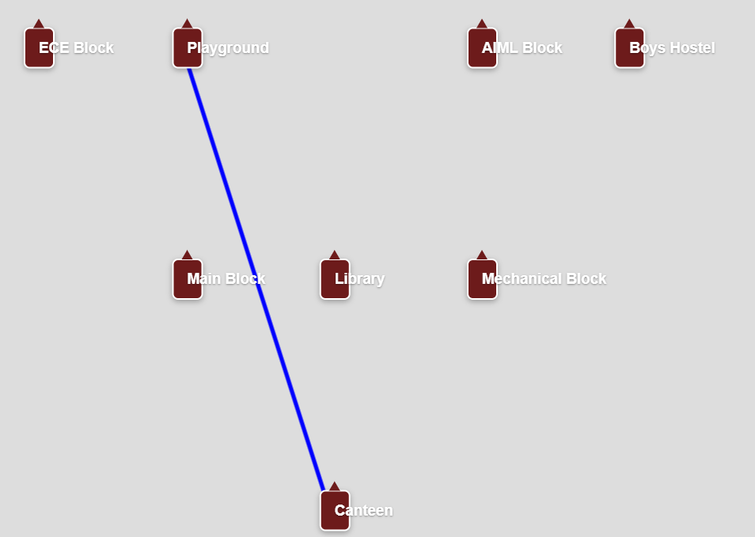
TECHNOLOGIES USED
Frontend: HTML5 & CSS3 (using Flexbox and CSS
Grid for the layout).
Mapping API: Leaflet.js (An open-source JavaScript
library for interactive maps).
Data Source: OpenStreetMap (OSM) for
tile rendering.
Logic: JavaScript (ES6+) for coordinate handling,
route polyline generation, and UI state management.

Slide 6
HOW THE APP FUNCTIONS
Data Layer: Pre-defined geographic coordinates (Latitude & Longitude) for all campus landmarks.
Map Initialization: The app centers on the campus coordinates ($17.0836^\circ N, 82.0536^\circ E$).
Event Handling: * openMap() handles the screen transition.
getDirections() calculates and draws the polyline between nodes.
locateMe() triggers the browser's Geolocation API

Slide 7
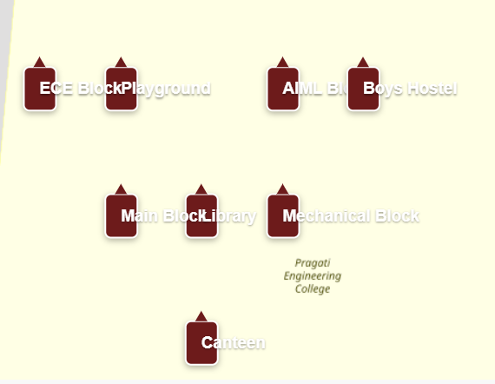
INTEGRATED CAMPUS POINTS
Academic: Main Block, Mechanical
Block, ECE Block, AIML Block.
Student Life: Library, Canteen,
Playground.
Residential: Boys Hostel.
Customization: The app uses custom
"Marker Tags" that auto-resize
based on the user's zoom level for better
readability.

Slide 8
UI/UX HIGHLIGHTS
Color Palette: Professional Deep Maroon (#6d1b1b) and White theme.
Navigation: Minimalist bottom controls for "Home" and "Locate.“
Feedback Loop: Integrated feedback prompt to gather user suggestions
for map updates.
Animations: Smooth "Fly-to" transitions when searching for specific
buildings.

Slide 9
SCALING THE PROJECT
Indoor Mapping: Adding floor-wise navigation for multi-story buildings.
Event Integration: Marking live locations for seminars, fests, or exams.
Augmented Reality (AR): Visualizing building names through the phone
camera.
Offline Mode: Using service workers to allow map access without an
active internet connection.

Slide 10
CONCLUSION
The Pragati Campus App is a robust, scalable solution for modern campus management.
It reduces navigation friction and improves the overall visitor experience.
Thank You!

